Slide 1


Lean – Six Sigma – Capability / SPC
UGain Black Belt in Lean – module 3: Geavanceerde Technieken in Lean – Six Sigma
Onderwerp: 2.5, lean toolbox referentie: 13
Dries Grymonprez
dries.grymonprez@arcelormittal.com
Notes:
You know already Lean (methodologies/techniques), what do you think of concerning Six Sigma?

Slide 2
Who is who?
Dries Grymonprez, ArcelorMittal Gent, CAPEX mgr / decarb
Six Sigma Black Belt, 2005, dries.grymonprez@arcelormittal.com
ArcelorMittal Belgium (www.arcelormittal.com/gent) – Steel Industry
Key messages & Facts & Key figures – see company film
https://www.youtube.com/watch?v=kLviIvK-yVA
Data = basis of everything
(incorporation of data analysis & statistics in company culture)
Maximal automation, modelling, already in 1970s
Top performing people (5 % of working time invested in training)
Each trainee can presents her- or himself + expectations
Exam
Notes:
Dries Grymonprez, progress team, PMO, carreer in R&D (during studies) – 3y, process modelling – operations research 9y, production (blast furnaces) 7y, progress 8y, now 2y CAPEX mgr AMBe + budget & cost decarbonization project 0 % CO2 2050 horizon, eerste installaties opstarten 2026 (elektrische smeltovens, gasprocessen ipv kolen gebaseerde processen, etc.)
3 week intensive international course black belt 2005 AM, Instituto De Desenvolvimento Gerancial, Brazil
Cfr. book of Falconi – Daily work routine management
Data basis of everything: start point for analysis - actions – continuous improvement
AMGent automation, pioneer in automation & modelling – highly automated plant, automate everything, e.g., overhead cranes, coil transport, decision and optimisation models, …
Now trends as big data, quick/uniform access to data projects, digitalization, statistical manager appointed, statistical tools as R/Statistica/SAS/Matlab/Python
WCM
Top performing people: investing in people: hiring the better profiles (get the right people on the bus, hire for attitude train for skills), starting jobs in modelling, automation, informatics, production. In general for all jobs > 5 % of time is invested in training (Jocely Alves, black belt course: study ½ per week for your own development – intrinsic motivation). Respect and team work are values of the company, besides openness and subsidiarity.

Slide 3
Wat zullen we behandelen vandaag?
Data
  Basisstasistiek: normale verdeling: spreiding (minimaliseren)
  Stabiliteit
  Capabiliteit → vs. klanteisen (Cp , Cpk)
  Control: SPC: statistische proces controle: regelkaarten

Slide 4
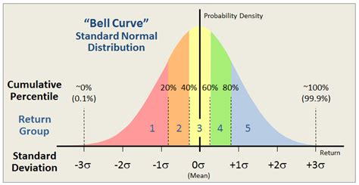
Wat zullen we behandelen vandaag?
DATA als basis
STATISTIEK
Normale verdeling – statistische technieken voor inzicht en om problemen op te lossen
Notes:
Data als basis voor verbeteren van alle processen / businesses / …
Statistiek, niet om de statistiek maar als middel om verbeteringen te gaan doen → deel van DMAIC

Slide 5
Agenda
13u30-15u30: deel 1 Process Capability
15u30-15u45: pauze
15u45-17u45: deel 2 Statistical Process Control (charts)
17u45-18u15: pauze (broodjes)
18u15-20u15: deel 3 Exercises
Notes:
Links between topics:
Lean & Six Sigma: introduction – what is Lean / what is Six Sigma and what is link in between.
After that: introduction to statistics (Six Sigma strongly statistically oriented – see the world in figures, in dispersion, and how to reduce dispersion)
DMAIC: break trough strategy, method to install Six Sigma projects, here we define our problem very detailed, set up a plan, deep dive into metrics / statistics to analyse the problem(s), perform an action plan and sustain (control charts, check up by KPIs, …), so that efforts are not lost.
Process capability is about how our processes perform and we monitor when we improve our processes. Also applicable on measurment gauges.
Statistical process control → to sustain
Hypothesis testing, two samples, ANOVA → statistical techniques to make a statement about a certain hypothesis
Design of experiments: often you have already data about a certain problem, if not, or if you want to do experiments in another region outside the knowledge, you can do experiments.
The method how to do these experiments, so that these experiments are reliable, cost effective is called DOE.

Slide 6
Leerdoelstellingen
Wat is capabiliteit van een proces en kunnen toepassen
Statistische proces controle:
  Concept en toepasbaarheid
  Hoe stellen we een eenvoudige regelkaart op
  Wat is out of control en hoe sturen we bij?
Oefeningen + interactiviteit
Algemene doelstelling:
belang van data verzamelen/analyse kennen & kunnen toepassen

Slide 7
Agenda
13u30-15u30: deel 1 Intro & Process Capability
15u30-15u45: pauze
15u45-17u45: deel 2 Statistical Process Control (charts)
17u45-18u15: pauze (broodjes)
18u15-20u15: deel 3 Exercises
Notes:
Links between topics:
Lean & Six Sigma: introduction – what is Lean / what is Six Sigma and what is link in between.
After that: introduction to statistics (Six Sigma strongly statistically oriented – see the world in figures, in dispersion, and how to reduce dispersion)
DMAIC: break trough strategy, method to install Six Sigma projects, here we define our problem very detailed, set up a plan, deep dive into metrics / statistics to analyse the problem(s), perform an action plan and sustain (control charts, check up by KPIs, …), so that efforts are not lost.
Process capability is about how our processes perform and we monitor when we improve our processes. Also applicable on measurment gauges.
Statistical process control → to sustain
Hypothesis testing, two samples, ANOVA → statistical techniques to make a statement about a certain hypothesis
Design of experiments: often you have already data about a certain problem, if not, or if you want to do experiments in another region outside the knowledge, you can do experiments.
The method how to do these experiments, so that these experiments are reliable, cost effective is called DOE.

Slide 8
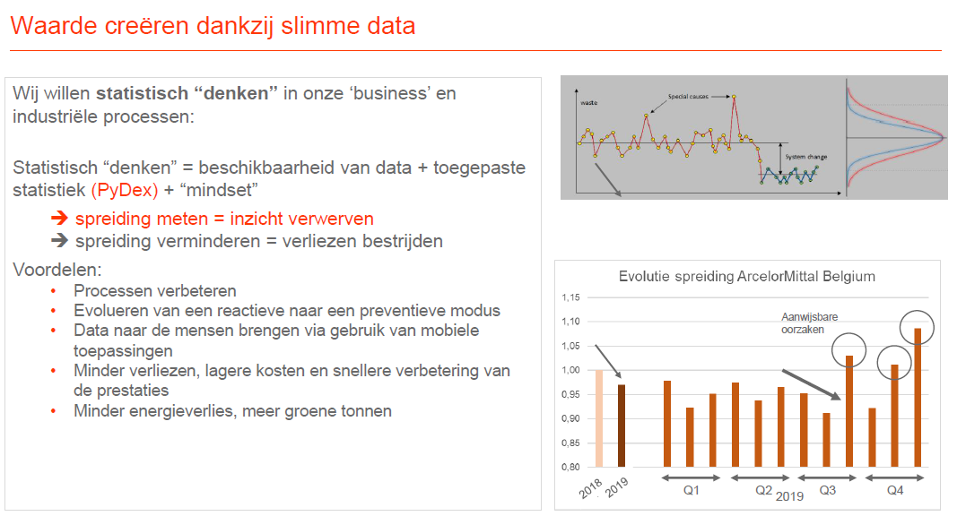

Slide 9
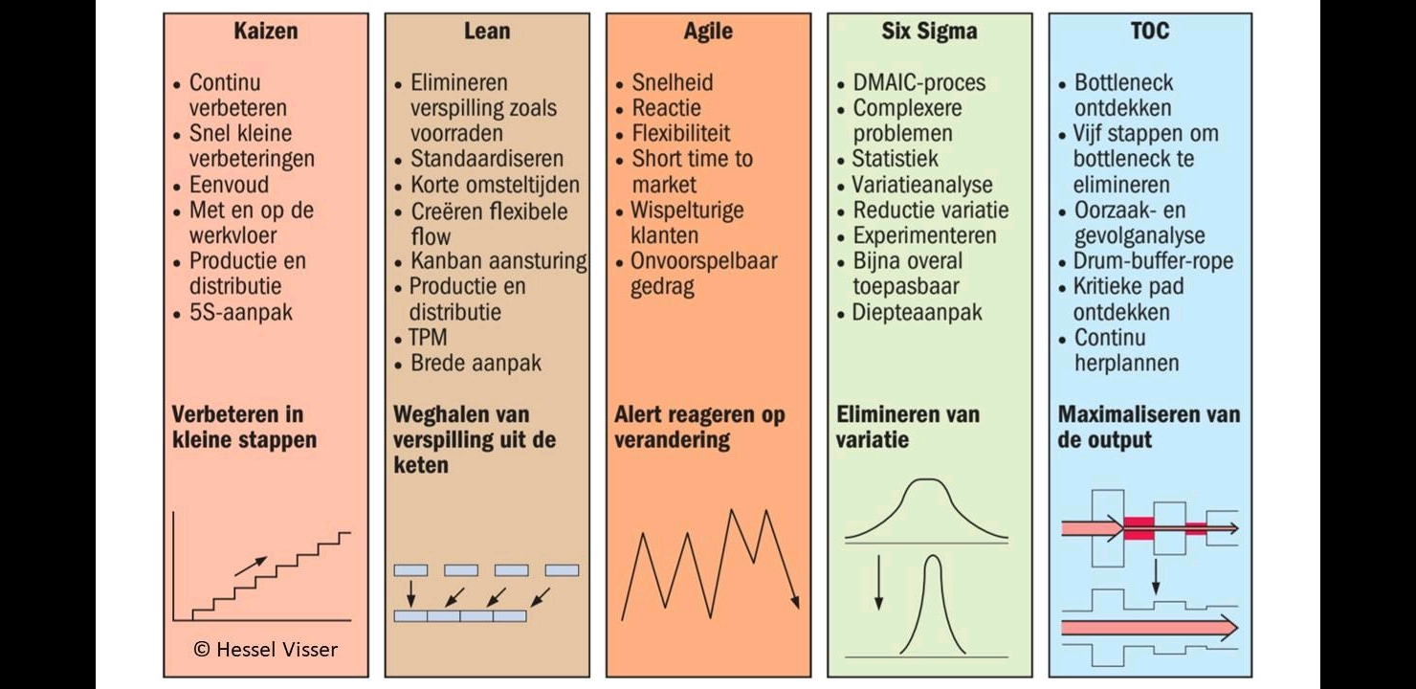
Methodologies landscape

Slide 10
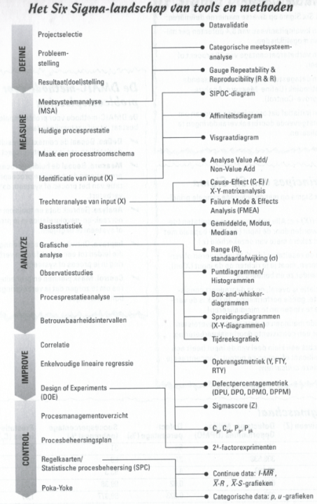
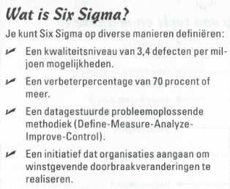
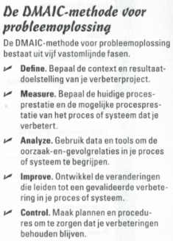
What is Six Sigma?*
* Source: Six Sigma for Dummies
Notes:
Result oriented

Slide 11
Six Sigma scientific - statistical point of view
Dispersion everywhere
(entropy – second law of thermodynamics) – dS/dt >= 0
Dispersion is expressed in variance / standard deviation (sigma)
Control dispersion → zero defects
Statistics – descriptive/analysis
Standard normal distribution – also other distributions
Nothing is sure – always a chance that a hypothesis is wrong
E.g., weather forecast

Slide 12
Data collection
As basis: observations & measurements to collect data (simple means, lab, on-line) with steps:
  Define well what you want to measure (what matters, independent variables)
  Choose data collection method: experiments, on-line, but also: surveys, interviews, ...
  Plan your data collection procedures (how will you measure, how accurate,
  what's your sampling plan?, standardization of measurements)
  Data collection
Data storage: on paper, but also of course digitalization, store in databases, for further analyses/studies

Slide 13
Sample size determination
Is always trade-off between accuracy of modelling & cost
Larger samples may provide more accurate information, but may also not provide additional accuracy or may even be dangerous: long-term effects may be included
General rule: sample at least 20, preferably 30 measurements
Sample size determination is a study on its own,
not an objective of this course.
More info: https://en.wikipedia.org/wiki/Sample_size_determination

Slide 14
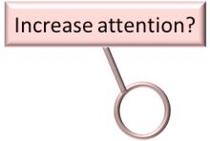
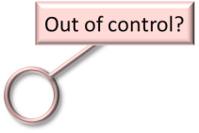


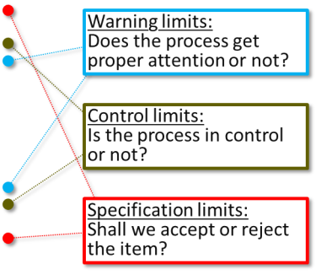
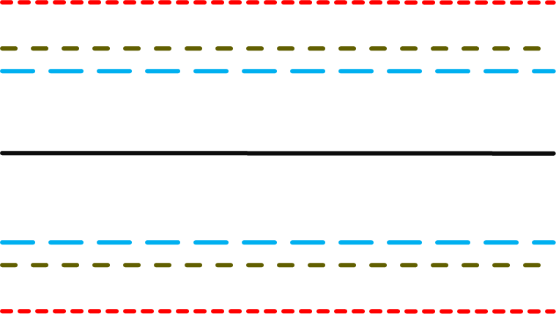
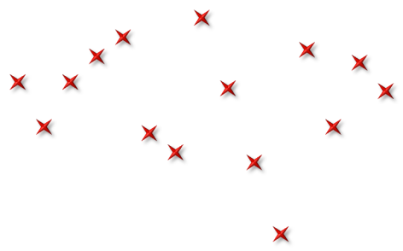
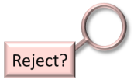


Notes:
X value, no average value → specs of customer are always on X values, not on means, otherwise you should recalculate the customer specs to average values of your samples.
St. dev of samples = st. dev individual points / sqrt (n) with n = number of measurements in the sample.

Slide 15
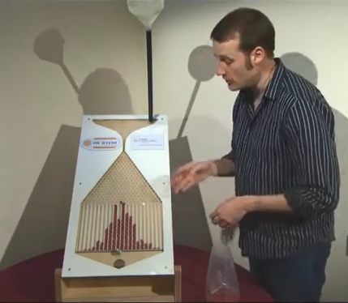
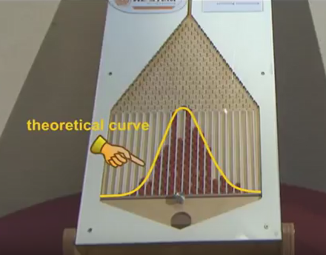
Galton Board
Galton Board
https://www.youtube.com/watch?v=6YDHBFVIvIs
Notes:
Klanten ervaren geen gemiddelden, maar variatie (Jack Welsh oud CEO van GE). Variatie beschrijven en analyseren doet u met statistische methoden en technieken.
Geen statistiek om de statistiek, maar statistiek gebruikt om problemen mee op te lossen.
Galton board
Toeval → normal distribution
More measurements to the center (gemiddelde), less to the outlines (maar het is de mate van spreiding & de outliers die problemen opleveren)
1 measurement / samples of steekproef (verkiezingsvoorspellingen) / populatie !
Een symmetrische verdeling
Heel wat verdelingen in de natuur zijn normaal verdeeld
Galton: sociologist: regression (least squares) → regression to the mean (e.g. tall father → also tall son, but slightly smaller).

Slide 16
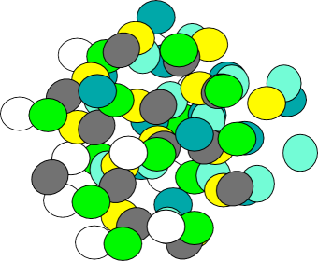




POPULATION (µ,σ)
SAMPLE ($\overline{x}$,s)
Sampling Scheme
Measure
Data!
Notes:
Sample theory
Check the reality

Slide 17
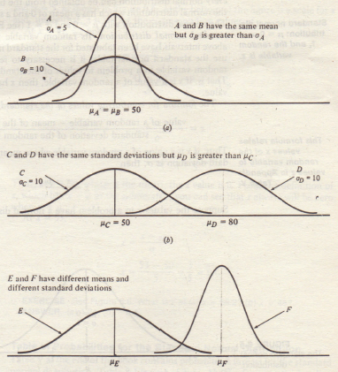
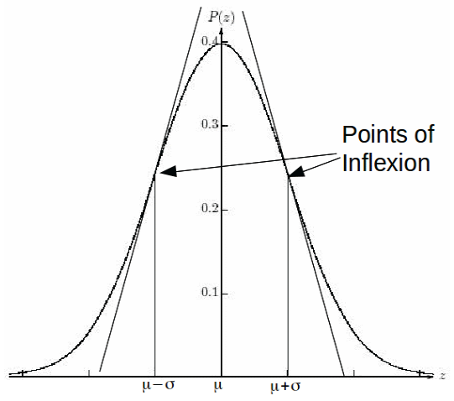
Normal distribution
Probability distribution (symetric)
Surface under curve = 100 %
Kurtosis (‘peak’ness)
Definition of sigma = inflexion point
Notes:
Waarschijnlijkheid
Het gaat over populaties: groepen van getallen --> bv. lengtes personen, schoenmaten personen, diktes/breedtes van staalplaten, kwaliteitsparameters zoals treksterkte, vetgehalte in melk, …

Slide 18
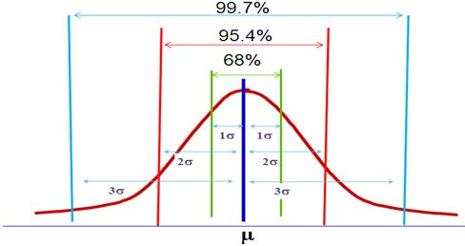
Hoeveel nog buiten 3 Sigma? 0,30 % totaal, dus 0,15 % links/rechts
Notes:
Slordige figuur.
Eenzijdig en 2 zijdig uitleggen
Probabiliteit / waarschijnlijkheid
Denken in eenzijdige sigma, niet in 2 zijdig, eenzijdig maakt de zaken eenvoudiger.
Symmetrische verdeling !!

Slide 19
(Standaard)normale verdeling
Laat toe om steekproeven uit verschillende populaties op een zinvolle manier met elkaar te vergelijken én gemakkelijker te rekenen
X∼N(μ,σ) met N = beste schatting
  E(X) = μ
  σ(X) = σ
  Belangrijke kengetallen :
    P[μ−σ ≤ X ≤ μ+σ] ≈ 68 %
    P[μ−2σ ≤ X ≤ μ+2σ] ≈ 95 %
    P[μ−3σ ≤ X ≤ μ+3σ] ≈ 99.7 %
Standaard normale Z belangrijk voor praktijk:
  E(Z) = 0
  σ(Z) = 1
Notes:
Wie bv. wil weten hoeveel % van de bevolking meer of minder weegt dan hem, kan dat eenvoudig berekenen op basis van gemiddelde en spreiding.
Schoenmaten mannen: gemiddelde: 42,5 + spreiding = 2,5 → grof gerekend: 3 sigma naar beneden: 35, 3 sigma naar boven: 50, maar er zal wel steeds iemand zijn die < 35 of > 50 heeft
Hier rekenen we altijd met effectieve waarden, maar je kunt dit ook relatief bereken, normaliseren: gemiddelde wordt 0 en spreiding wordt: 1. Dan kunnen alle normale distruties met elkaar vergeleken worden.
Iedere individuele waarde wordt omgezet naar Z-waarde (relatieve waarde): ( absolute waarde – gemiddelde ) / spreiding

Slide 20
Calculating Process Capability Discrete Data
Yield and Defect Count
Yield and Defect Counts are related measures
Calculations
D
N•O
Yield represents the percent of good products or services (measured in %)
DPO =
D DPMO = 1,000,000 • _{N•O}
Defect Counts monitor the number of times things go wrong [measured in
Defects Per Opportunity (DPO) or Defects Per Million Opportunities (DPMO)]
PPM = parts per million
(+ % to PPM: factor 10.000)
Yield = 1 –
D
N•O
Key:
D = Number of defects
N = Number of units
O = Opportunities per unit
Notes:
Per product: OK or NOK, but you can have differente quality parameters: steel strip: length, with, thickness, mechanical properties, color, oil thickness, …
Defective: something is defective 1/0 (binary) → this is what the customer sees – this can be due to 1 or more defects in your product
Defects

Slide 21
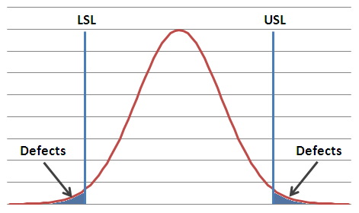
VOC vs. VOP
Sigma Capability | Defects per Million Opportunities | % Yield
2 | 308,537 | 69.15%
3 | 66,807 | 93.32%
4 | 6,210 | 99.38%
5 | 233 | 99.98%
6 | 3.4 | 99.99966%
Voice of Customer
Voice of Process
The Voice of the Process is independent of the Voice of the Customer
Notes:
Voice of the customer – voice of the process

Slide 22
Goals of Lean Six Sigma
LSL
USL
LSL
USL
Defects
Defects
Defects
Customer Target
Customer Target
Prevent Defects by
Reducing Variation
Prevent Defects by
Centering Process
LSL
USL
Customer Target
Meet Customer Requirements
Notes:
Exception for trying to reach the middle: for example is you have a low spread, you can choose to get as close to a specific customer requirements, because for example you have consumption that you want to lower --> Zn on plate, you set you as close as possible to the minimal Zn layer thickness.

Slide 23
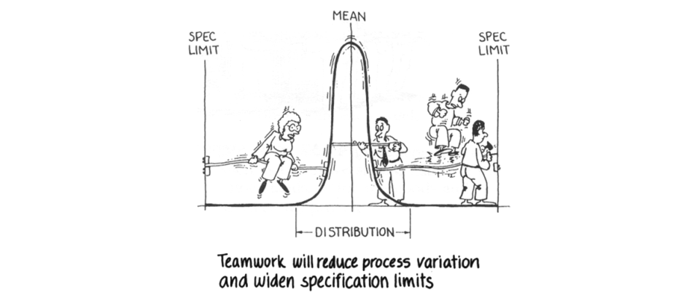
Six Sigma = team work
Notes:
Distributie zo nauw mogelijk maken (spreiding verminderen), gemiddelde zoveel mogelijk in midden krijgen (meest kans om binnen specificatie limits te blijven)
Cfr. ook capabiliteit hoofdstuk

Slide 24
Basic statistic techniques and tools
Do your own calculations, visualize data
Clean your data (outliers, bad or missing data, …)
Excel – statistical formulas and functions
Statistical packages:
  R + R studio (free software)
  Minitab
  Matlab/Python
  Statistica, SAS, …
A tool helps you in analysis phase of problem solving, awareness of statistics is important: you have to know what you are doing
Notes:
Make sure you have data
Vizualize your data
Use gradually more statistics in your company

Slide 25
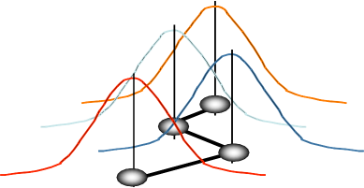
Process Variation – Pre-Project
mean shift
short term performance
group 4
group 3
group 2
group 1
long term performance
Groups of days, weeks, batches, customers, business units, sites, sales reps, marketing strategies, etc…
.
LSL
Target USL
Notes:
Lower – upper specification limit

Slide 26
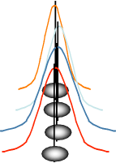
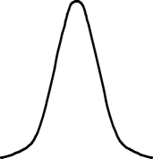
Process Variation – Post-Project
reduce dispersion or “spread”
shift mean
short term performance
group 4
group 3
group 2
group 1
long term performance
.
LSL
Target
USL

Slide 27



Process stability and capability must be improved in order to improve product and process quality
Basic laws of physics teach that:
A stable process has a minimum dispersion
Each process, running on its own, eventually becomes unstable
The dispersion of such a process will increase in a natural but unavoidable way
Eventually, there comes a time that we have problems due to process instability
Most processes can be described using statistical principles:
This forms the foundation of the Statistical Process Control (SPC), which can be used to stabilize a process, thus improving the process capability.
If a characteristic of a product is the result of a process with only natural deteriorations, then the measurement distribution of this characteristic will follow a normal distribution
A standard Normal Distribution is governed by:

Slide 28
Normal distribution
Common distribution is normal distribution
Dispersion by natural/physical causes are normal distributed
Central limit theorem:
  Averages of different samples with sample number n are normal distributed
  Spread = spread population / sqrt (sample number n)
There are also other distributions – examples
Visualize data to see the distribution / outliers / …
Statistical calculation such as averages, spread … only correct when the distribution is a normal distribution
Notes:
Vizualize data !
In all what you do: check reality (checkup with reality)

Slide 29
Agenda
13u30-15u30: deel 1 Intro & Process Capability
15u30-15u45: pauze
15u45-17u45: deel 2 Statistical Process Control (charts)
17u45-18u15: pauze (broodjes)
18u15-20u15: deel 3 Exercises
Notes:
Links between topics:
Lean & Six Sigma: introduction – what is Lean / what is Six Sigma and what is link in between.
After that: introduction to statistics (Six Sigma strongly statistically oriented – see the world in figures, in dispersion, and how to reduce dispersion)
DMAIC: break trough strategy, method to install Six Sigma projects, here we define our problem very detailed, set up a plan, deep dive into metrics / statistics to analyse the problem(s), perform an action plan and sustain (control charts, check up by KPIs, …), so that efforts are not lost.
Process capability is about how our processes perform and we monitor when we improve our processes. Also applicable on measurment gauges.
Statistical process control → to sustain
Hypothesis testing, two samples, ANOVA → statistical techniques to make a statement about a certain hypothesis
Design of experiments: often you have already data about a certain problem, if not, or if you want to do experiments in another region outside the knowledge, you can do experiments.
The method how to do these experiments, so that these experiments are reliable, cost effective is called DOE.

Slide 30
Oorzaken van niet-stabiliteit
Stabiliteit: proces enkel op toevallige wijze beïnvloed - proceskenmerken vertonen toevallige variaties
“common causes” versus “special causes”
Systematische oorzaak : geleidelijk verloop distributie (ST)
Aanwijsbare oorzaak : abrupte wijziging distributie (LT)
Notes:
Een productieproces heeft vele bronnen van variatie: de complexe interactie tussen materialen, gereedschappen, machines, werkmethodes, operatoren en omgeving zorgen voor variabiliteit.
2 vormen van “special causes”:
Vb. van systematische oorzaak: slijtage
Vb. van aanwijsbare oorzaak: procedurewijziging, nieuwe machine, ander materiaal (kan ook onregelmatig zijn, zoals stroompieken)
Het ontdekken van special causes en actie nemen is meestal de verantwoordelijkheid voor iemand direct verbonden met de bewerking, terwijl de correctie van common causus meestal tot de verantwoordelijkheid van het management behoort.

Slide 31
Common vs. Special Causes of Variation
Type of Variation | Deﬁnition | Typical Characteristics
Common Cause Special Cause | Process is running within its normal operating range (Short term) Process displays variation outside what is expected (Long term) | Expected Predictable range of values Purely Random Unexpected Unpredictable range of values Not Purely Random

Slide 32
A process is said to be stable, predictable and in control if only common cause variability is present
With common cause only
With assignable causes
Time
Frequency for each size
Product Size
Consistent & stable
Distribution can be predicted
High variability
Impossible to predict future condition
Source: McKinsey
Notes:
Stability to be looked on on short/mid/(long) term

Slide 33
Process capability - C_{p} – C_{pk}
C = Capability, p = process, pk = process + Japans woord voor off-center
2 sided specification limits, one side: only Cpk can be calculated (example Zn layer thickness)
C_{p}
Breedte van de distributie (spreiding) t.o.v. toegelaten interval, Op zich niet voldoende.
(common cause – process engineer)
C_{pk}
Ligging van gemiddelde t.o.v. toegelaten interval
(special cause – operator by doing adjustments)
Korte termijn: C_{p} / C_{pk}
Lange termijn (waarin de klant geïnteresseerd is): P_{p} / P_{pk}
_{P = Performance}
Notes:
Cp / Cpk → met korte termijn sigma gerekend – white noise (within variation)
Pp / Ppk → met lange termijn sigma gerekend - black noise → over time – important for customer – the real parameter

Slide 34
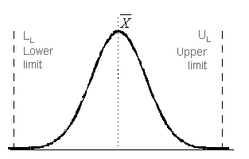



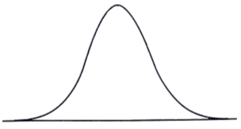
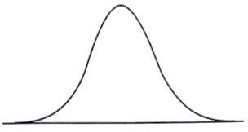
The Process Capability (C_{P}) compares the process dispersion with the target given by the specification (U_{L} and L_{L})¹
C_{P} is however not sufficient to define if a process is capable or not:
C_{P} = 2
C_{P} = 2
L_{L}
U_{L}
L_{L}
U_{L}
¹ U_{L} – Upper Limit; L_{L} – Lower Limit
Notes:
Cp / Cpk: Cpk = Japans woord voor off-center
Pp / Ppk: P from performance

Slide 35
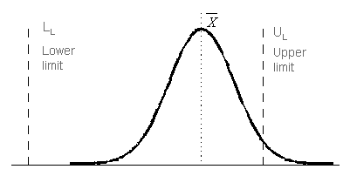
The Process Capability (C_{PK}) compares the process dispersion with the target given by the specification
C_{PK} = D₁ / D₂
Forced
Evolution
L_{L}
U_{L}
Waste
D₁
D₂
Average

Slide 36
What do we Need?
LSL
USL
LSL
USL
Off-Target, Low Variation
High Potential Defects
Good C_{p} but Bad C_{pk}
On Target
High Variation
High Potential Defects
No so good C_{p} and C_{pk}
LSL
USL
Variation reduction and process centering create processes with less potential for defects.
The concept of defect reduction applies to ALL processes (not just manufacturing)
On-Target, Low Variation
Low Potential Defects
Good C_{p} and C_{pk}
Notes:
Improve Cpk is easier → calibrate, operator can correct this, normally 1 or 2 factors.
Improve Cp is much more difficult: multitude of factors, mostly for process engineer
If Cp sucks, don’t calculate Cpk
Sheward: common cause: characteristic by simple distribution, special cause: shift in your distribution.

Slide 37
Technical Definition of Six Sigma
75%
LSL
±1.5
USL
σ
12.5%
12.5%
C_{p}=2, C_{pk}=1.5
C_{p}=2, C_{pk}=1.5
3.4 DPMO
C_{p}=C_{pk} = 2
3.4 DPMO
-
6σ −5σ −4σ
-3
σ −2σ −1σ 0 +1σ +2σ +3σ +4σ +5σ +6σ
6σ
to LSL
6σ
to USL
Evolution to:
A Management driven, scientific methodology for product and process improvement which creates breakthroughs in financial performance and Customer satisfaction
Notes:
Why introduce a 1.5σ shift?
Real-world processes are not perfectly stable. Over time, they drift due to:
tool wear
temperature changes
operator differences
material variation
calibration drift
Motorola (where Six Sigma originated) observed empirically that a process mean can shift by about ±1.5 standard deviations over the long term.
Why specifically 1.5σ?
It’s not a universal law—it's:
an empirical observation from early industrial processes
a conservative assumption to account for real-world variation
Think of it as:
“Even if your process looks perfect today, expect it to degrade over time.”

Slide 38
Process stability influences performance, predictability and capability
Stable & Predictable
Unstable & Unpredictable
11h
9h
10h
8h
Capable
Not capable

Slide 39
Some notes on Process stability
An unstable process is unpredictable; a stable process is predictable (not on a piece by piece level, but over time, in the sense like described in the previous slide).
Stability (and hence predictability) comes from common causes of variation; lack of stability (and hence no predictability) comes from special causes of variation.
The ideal situation is a stable and sufficiently capable process.
So both special and common causes under control !

Slide 40
The Process Capability (C_{P} & C_{PK}) can be used to predict the capability of a process to produce a certain product
If the deviation is centred between the lower and upper limits (C_{P}=C_{PK}):
C_{P} < 1 The process is not capable to produce products properly.
C_{P} = 1 The process is just capable to produce products properly. About 2700 items out of 10⁶ items are out of tolerances.
Specification = U_{L}– L_{L}= 6σ → 99.73%
C_{P} >= 1.33 The capability of the process is acceptable. About 60 items out of 10⁶ items are out of tolerances (64ppm).
Specification = U_{L}– L_{L}= 8σ → 99.9936%
C_{P} >= 1.67 The capability of the process is good. About 0,57 items out of 10⁶ items are out of tolerances.
Specification = U_{L}– L_{L}= 10σ → 99.999943%
C_{P} = 2 6 Sigma quality level – 2 defect per billion of opportunities
(short term)

Slide 41
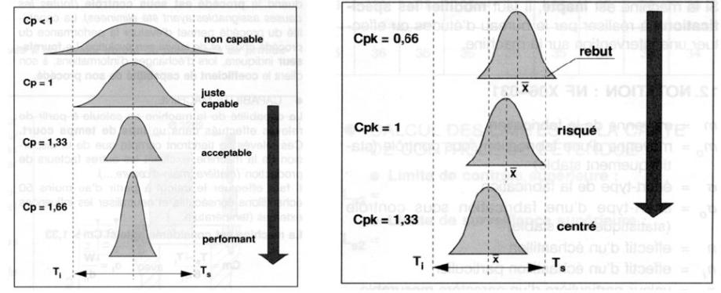
The Process Capability (C_{P} & C_{PK}) can be used to predict the capability of a process to produce a certain product
Not capable
Scrap
Just capable
Risky
Acceptable
Good
Good

Slide 42
The Process Capability (C_{P} & C_{PK}) can be used to predict the capability of a process to produce a certain product
Good C_{P} and Good C_{PK}
Good C_{P} but bad C_{PK} – Adjustment needed
TQM 2001 RD
TQM 2001 RD
Stable & Capable
Stable & Potentially Capable
Bad C_{P} and bad C_{PK} – Long term problems
Good C_{P} and good C_{PK} – Acceptable (for now…)
TQM 2001 RD
TQM 2001 RD
Stable but not Capable
Unstable but Capable

Slide 43
The Process Capability (C_{P} & C_{PK}) can be used to predict the capability of a process to produce a certain product
Good C_{P} and bad C_{PK} – Urgent action needed
Bad C_{P} and bad C_{PK} – not desperate but…
TQM 2001 RD
TQM 2001 RD
Unstable & Potentially Capable
Unstable & Not Capable

Slide 44
The table below can be used as a guide when considering process capability
 | Parameter |  |  | Comments
 | Stability | Capability C_{P} | Capability C_{PK}
 | + | + | + | Keep it this way
 | + | + | - | Simple question of adjustment (operator)
 | + | - | + | Impossible
 | + | - | - | Long term and difficult solutions (engineer)
 | - | + | + | The first blunder…
 | - | + | - | Urgent reaction needed…
 | - | - | + | Impossible
 | - | - | - | Not desperate but …
Process Status

Slide 45
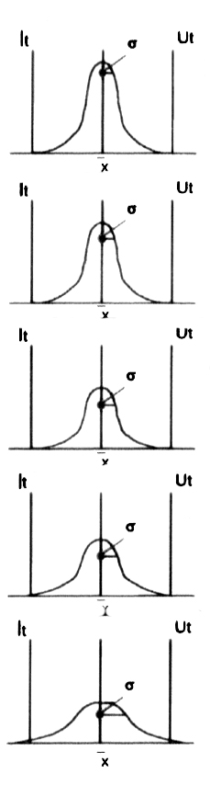
The table below can be used as a guide when considering process capability
C_{P} | Distribution | Judgment | Action
C_{P} ≥ 1.67 |  | Process capability is more than enough. | Simplification of process control and cost reduction can be considered in certain cases. Quarterly sampling on products
1.67 > C_{P} ≥ 1.33 |  | Process capability is sufficiently high. | Ideal condition. Maintain it. Regular sampling on products
1.33 > C_{P} ≥ 1.00 |  | Process capability is not sufficiently high, but is adequate. | Control process properly and maintain it in a control state. Defects may result if Cp approaches 1 Take action if needed. Frequent sampling on products
1.00 > C_{P} ≥ 0.67 |  | Process capability is not sufficient. | Defects have been generated. Screening inspection, process control and Kaizen will be required. All products must be checked
0.67 > C_{P} |  | Process capability is very low. | Cannot satisfy quality. Quality must be improved, cause must be pursued and emergency actions must be taken. Reexamine standards. All product must be checked

Slide 46
Proces capabiliteit: oefening
Een as die wordt gebruikt in een automatische transmissie moet een lengte hebben tussen 71,4 mm en 72,8 mm. Het productieproces wordt gemonitord met een Xbar-kaart en een s-kaart, met steekproeven van lengte 5
De kaarten tonen aan dat het proces beheerst verloopt. Uit de kaarten blijkt dat Xbar = 71,8 mm en sbar = 0,2 mm
Is dit proces geschikt om aan de specificaties van de klant te voldoen?
Hoeveel % uitval mogen we verwachten?
Wat als gemiddelde in het midden gelegd wordt? Wat wordt dan Cp?, Cpk?, uitval?
Notes:
71,4 → 72,8 mm
Cp = (72,8 – 71,4) / 6.0,2 = 1,4/1,2 = 1,166
Cpk = min ( (72,8-71,8) / (3.0,2) , (71,8 – 71,4)/(3.0,2)) = min (1,67 , 0,67) = 0,67
0,67.6 sigma = 4,02 sigma = 95 %, 5% uitval, 50.000 ppm, 1 zijdig: 2,5% of 25.000 ppm
Norm.verd(71,4 ; 71,8 ; 0,2 ; cumulatief = waar)
Gemiddeld in het midden →
Cp = gelijk = 1,166
Cpk = 0,7 / 0,6 = 1,166
(72,1-71,4)=0,7 → 0,7/0,2 = 3,5
Uitval: 3,5 sigma = 1 zijdig 0,02 % of 200 ppm, maar je moet hier 2 zijdig rekenen: 0,04 % of 400 ppm

Slide 47
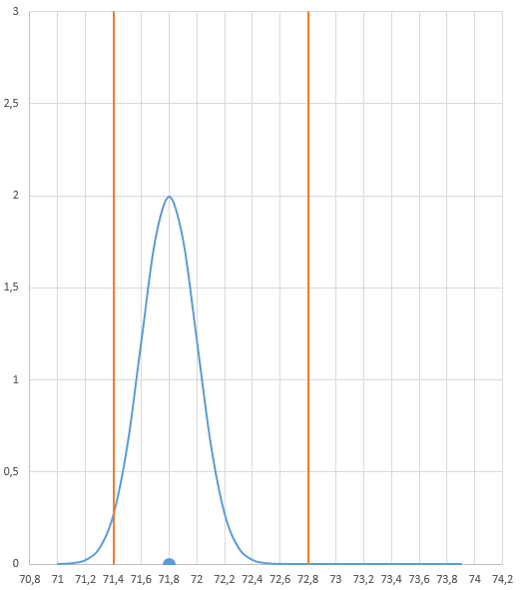
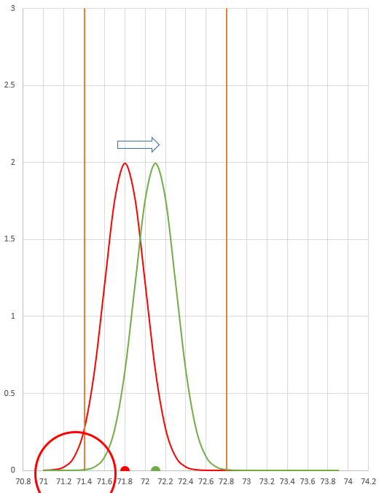

Slide 48
Minitab capability example

Slide 49
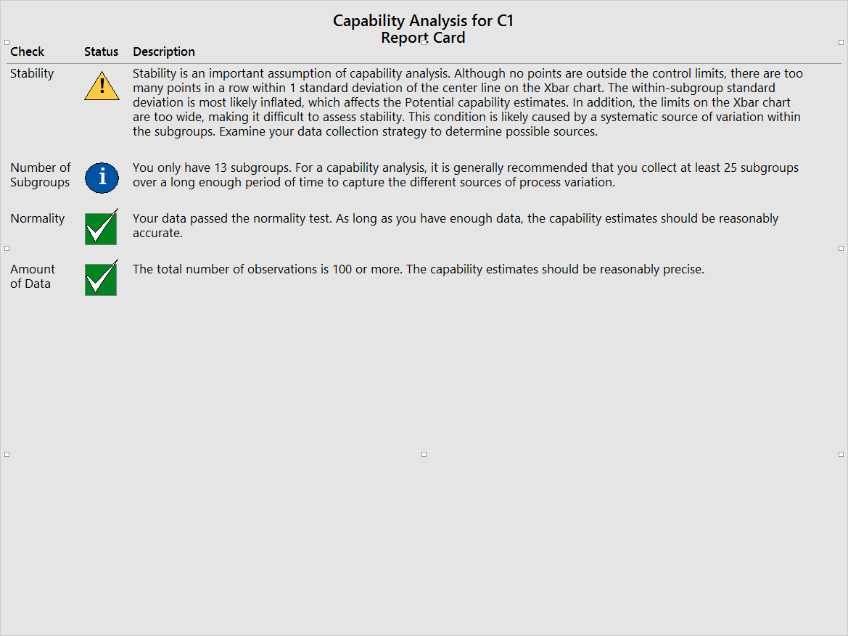

Slide 50
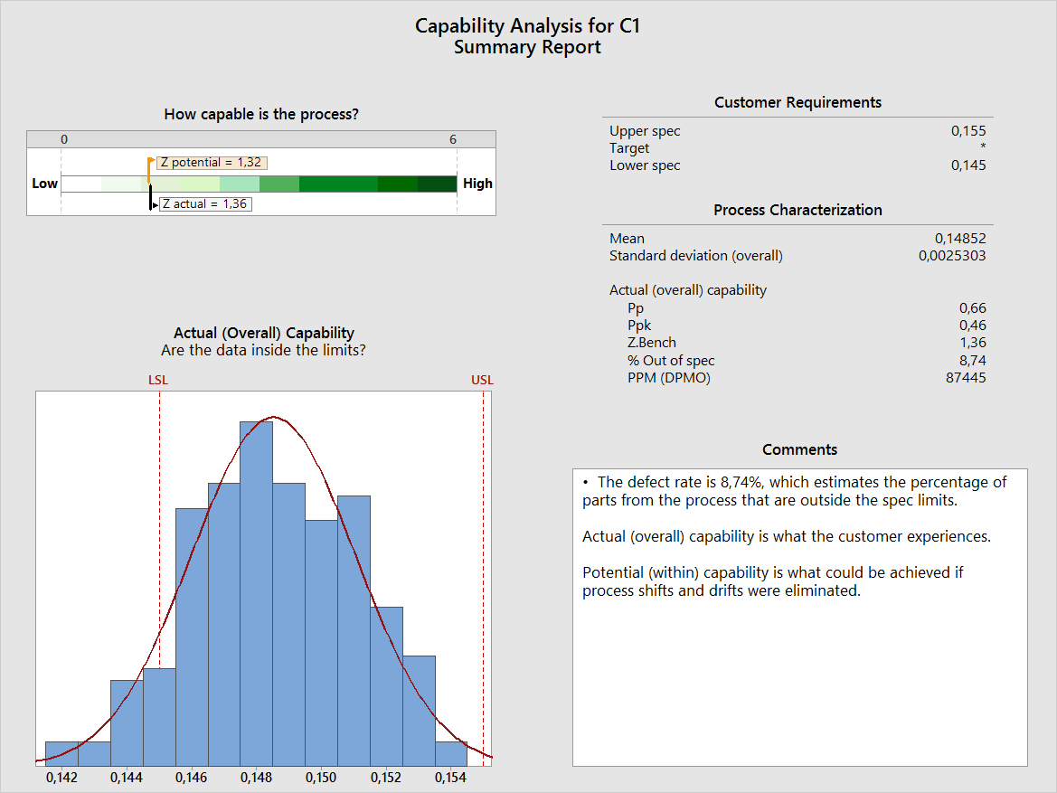

Slide 51
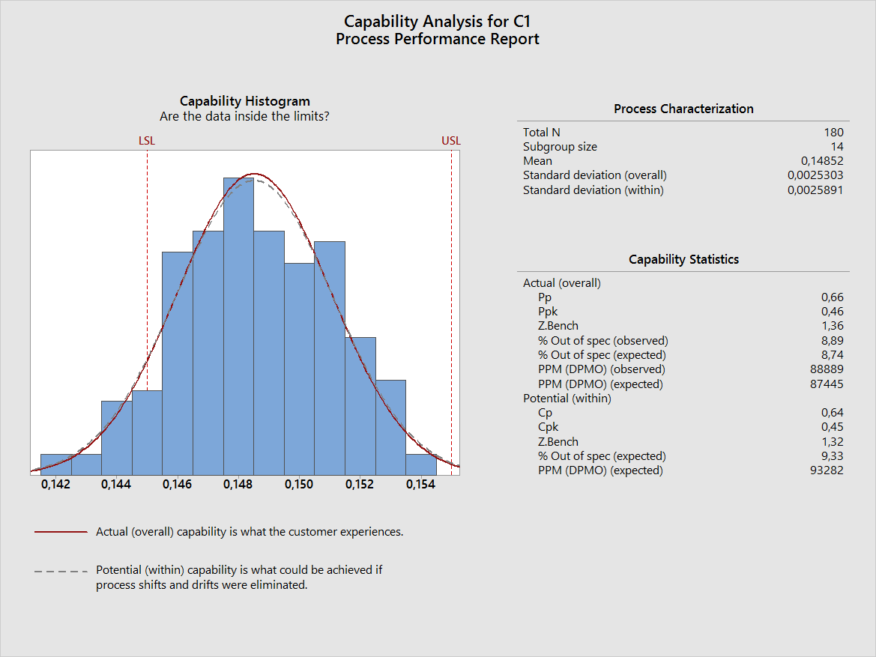

Slide 52
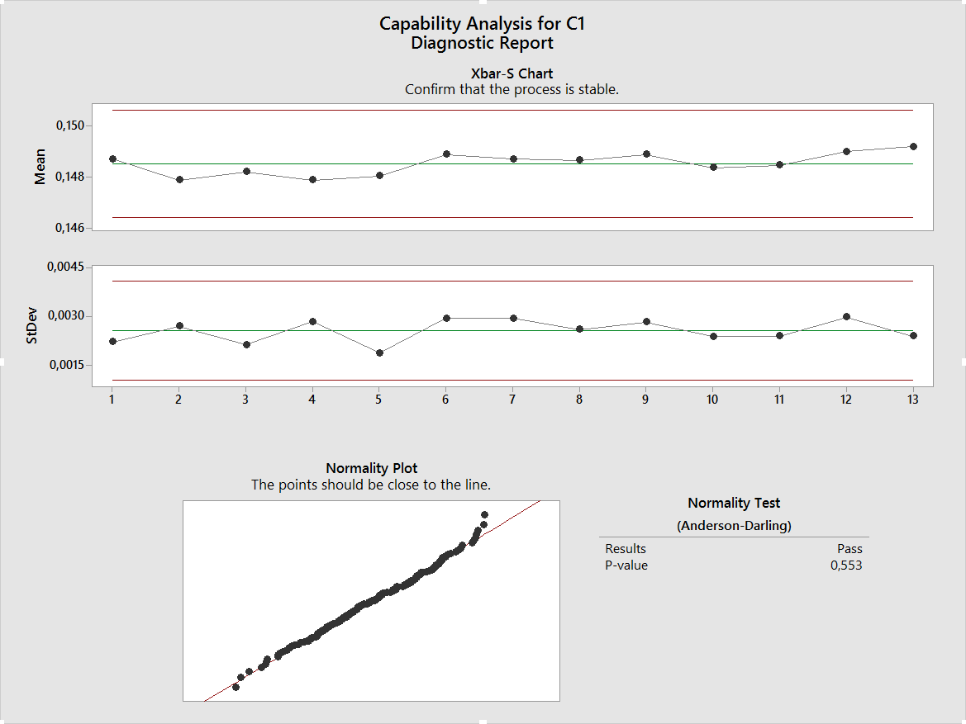

Slide 53
Agenda
13u30-15u30: deel 1 Intro & Process Capability
15u30-15u45: pauze
15u45-17u45: deel 2 Statistical Process Control (charts)
17u45-18u15: pauze (broodjes)
18u15-20u15: deel 3 Exercises
Notes:
Links between topics:
Lean & Six Sigma: introduction – what is Lean / what is Six Sigma and what is link in between.
After that: introduction to statistics (Six Sigma strongly statistically oriented – see the world in figures, in dispersion, and how to reduce dispersion)
DMAIC: break trough strategy, method to install Six Sigma projects, here we define our problem very detailed, set up a plan, deep dive into metrics / statistics to analyse the problem(s), perform an action plan and sustain (control charts, check up by KPIs, …), so that efforts are not lost.
Process capability is about how our processes perform and we monitor when we improve our processes. Also applicable on measurment gauges.
Statistical process control → to sustain
Hypothesis testing, two samples, ANOVA → statistical techniques to make a statement about a certain hypothesis
Design of experiments: often you have already data about a certain problem, if not, or if you want to do experiments in another region outside the knowledge, you can do experiments.
The method how to do these experiments, so that these experiments are reliable, cost effective is called DOE.

Slide 54
SPC – Control charts

Slide 55
Wat is SPC ?
SPC = Statistical Process Control
(Statistische Procesbeheersing)
Techniek om stabiliteit productieproces te bewaken
(bescherming tegen aanwijsbare, niet tegen systematische oorzaken)
Stabiel proces = distributies proceskenmerken zijn constant over de tijd (bv. N(μ,σ) met μ en σ constant)
Opvolging d.m.v. regelmatige controles van essentiële proceskenmerken (= statistische fase)
Indien controle NOK dan actie (= engineering fase)

Slide 56

Control Limits are Not Specifications
70
60
50
40
30
20
10
0
USL 6 s
UCL 3 s
LCL 3 s
LSL 6 s
© Veltion, 2013 | ww
Customer Specification Limits (USL, LSL)
- Defined based on feedback from the customer(s)
- Help determine if your process is producing
- Plotted on histograms (not control charts)
- Represent the voice of the customer
Control Limits (UCL, LCL)
- Defined based on process performance (+/- 3 estimated standard deviations from the mean)
- Help determine if your process is “in control” (without special cause variation)
- Plotted on control charts
- Represent the voice of the process
defects
Notes:
Regelgrenzen
Tolerantiegrenzen

Slide 57


Purpose for Using Control Charts
F R E Q U
E N C Y
SPECIAL CAUSE
UCL
LCL
SPECIAL CAUSE
TIME
© Veltion, 2013 | www.veltion.be
The Control Limits probabilistically separate common cause and special cause variability.
90

Slide 58
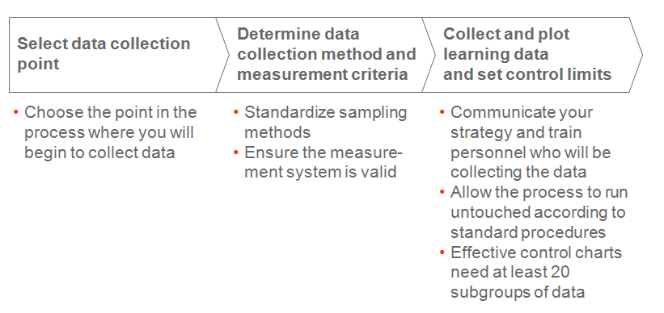
SPC process set up

Slide 59
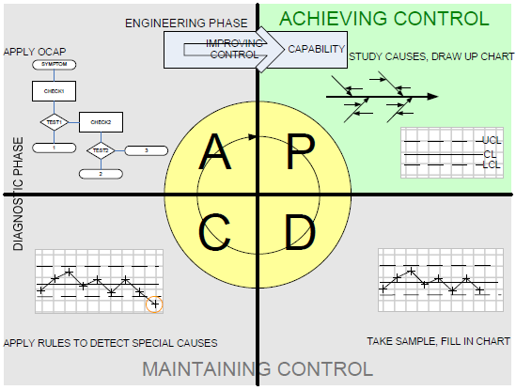
SPC: de PDCA-cirkel
Notes:
In the implementation of statistical process control, we distinguish between two phases : (1) achieving (and improving) control
and (2) maintaining control. To achieve control we study the causes of variation and then try to eliminate the special causes while
gaining a thorough understanding of the remaining permanent factors (the common causes). Once control is achieved, it has to be
maintained. This is done with the use of control charts. In fact the whole process is a PDCA cycle.
When the chart indicates the presence of a special cause, action has to be taken. This is normally the task of the operator(s). To
support the operator in finding what special cause occurred in this specific instance, an OCAP (Out of Control Action Plan)
accompanies the chart. The OCAP takes the operator through a sequence of questions and checks, to find out what went wrong.
When the OCAP does not lead to an appropriate answer, management becomes involved to investigate the case and (possibly)
adopt the OCAP. Finding the special cause in case of an ‘out of control signal’ is called the diagnostic phase. Improving the
OCAP in case it does not lead to an appropriate decision is called the engineering phase.

Slide 60
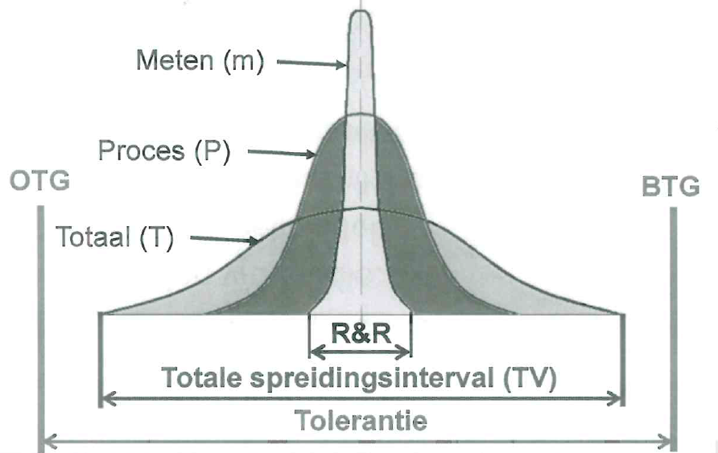
Spreiding door meetinstrument

Slide 61
Gauge R&R (MSA) impact measurement gauge
σ²_{Total} = σ²_{Part-Part} + σ²_{R&R}
Recommendation:
Resolution ≤ 10% of tolerance to measure
Gauge R&R ≤ 20% of tolerance to measure
R&R
Part-Part
Repeatability (Equipment variation)
  Variation observed with one measurement device when used several times by one operator while measuring the identical characteristic on the same part.
Reproducibility (Appraised variation)
  Variation obtained from different operators using the same device when measuring the identical characteristic on the same part.
Stability or Drift
  Total variation in the measurement obtained with a measurement obtained on the same master or reference value when measuring the same characteristic, over an extending time period.
Notes:
Also: measurement spread or influence of operator

Slide 62
Some notes on SPC
The measurements distribution will be fixed (and quite often be normal distributed) when a process is only influenced by common causes of variation.
Natural deteriorations are unavoidable deteriorations like wear, fatigue, ... When these occur and are not countered through e.g., good preventive maintenance, the process will become or will not be stable!
SPC is indeed based on the normal distribution, however we cannot state that every process distribution will follow the normal law. Quite often it will be the case, but there are exceptions.
→ averages of samples follow however always normal distribution, central limit theorema

Slide 63
De Xbar-kaart
Zij proceskenmerk X ~ N(μ₀,σ₀)
SPC volgt stabiliteit op via regelmatige controles: nagaan of μ₀ en σ₀ constant blijven (aanname: N blijft)
controle μ₀ via zgn. - kaart: bij elke controle (klein) sample nemen en gemiddelde berekenen; dit uitzetten in grafiek met controlelijnen (centrale limietstelling: normale verdeling van gemiddelden)

Slide 64
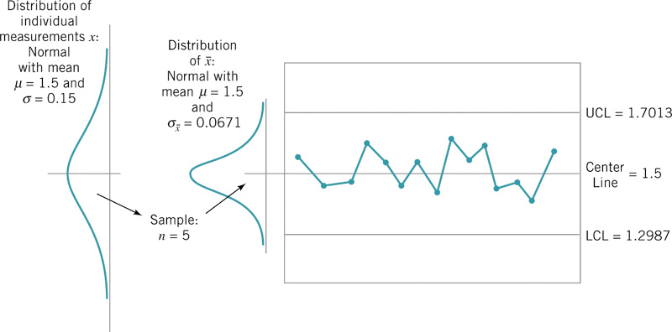
De Xbar-kaart
Notes:
Bij deze slide uitleggen wat het verschil is tussen sigma (= spreiding van het proces) en sigma(xbar) (= spreiding van de steekproefgemiddeldes). Ook uitleggen hoe je aan de formule komt: sigma(xbar) = sigma/wortel(n) (centrale limietstelling)
UCL = gemiddelde + 3*sigma(xbar) => 3-sigma limiet, omgekeerd evenredig met steekproefgrootte n.
Andere belangrijke formule: schatting v. sigma = Rbar/d2
Sigma gemiddelde = sigma / wortel van n
Sigma = Rbar / d2

Slide 65

Review: Acting On Control Chart Information
Two Types Of Mistakes
How you treat variation...
Common Causes
Special Causes
Focus on fundamental process change | Mistake 1 Tampering (increases variation)
Mistake 2 Underreacting (missed prevention) | Focus on investigating special causes
© Veltion, 2013 | www.veltion.be 92
Common Causes
What the variation really is...
Special Causes

Slide 66




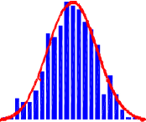


Review: Control Limits vs. specification limits
Upper Control Limit
Lower Control Limit
In Control
Capable of Meeting Specification
Lower Spec LC
L
UCL
Upper Spec
Out of Control
Upper Control Limit
50
70
90
110
130
150
Lower Control Limit

Slide 67
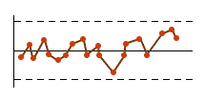
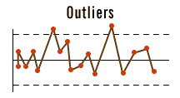
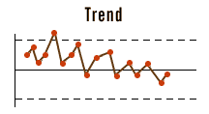
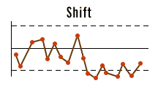
Control Charts Provide Decision Rules to
Determine when a Process is IN CONTROL
Process IN STATISTICAL CONTROL
Random Variation around the Target
All points within the control limits
Corrective Action Needed
Isolated points outside control limits
Long-term trends up or down
Shi<s away from the Target

Slide 68
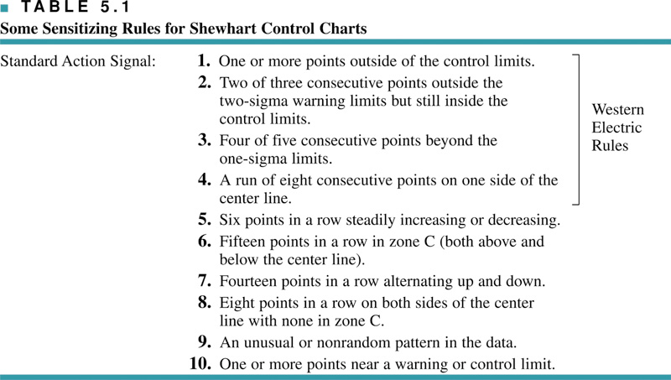
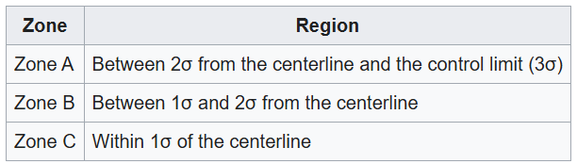
Western Electric regels

Slide 69
Western Electric regels
Western Electric rules - Wikipedia

Slide 70


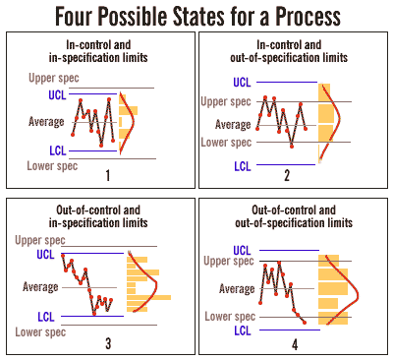
CAUTION:
Process in Statistical Control ≠ Process Satisfies Customer Requirements
© Veltion, 2013 | www.veltion.be
95
Notes:
Here we have UCL/LCL and USL/LSL on the same graph, but in fact it’s not feasable: you have to recalculate the USL/LSL (sample averages versus specification limits)

Slide 71
Agenda
13u30-15u30: deel 1 Intro & Process Capability
15u30-15u45: pauze
15u45-17u45: deel 2 Statistical Process Control (charts)
17u45-18u15: pauze (broodjes)
18u15-20u15: deel 3 Exercises
Notes:
Links between topics:
Lean & Six Sigma: introduction – what is Lean / what is Six Sigma and what is link in between.
After that: introduction to statistics (Six Sigma strongly statistically oriented – see the world in figures, in dispersion, and how to reduce dispersion)
DMAIC: break trough strategy, method to install Six Sigma projects, here we define our problem very detailed, set up a plan, deep dive into metrics / statistics to analyse the problem(s), perform an action plan and sustain (control charts, check up by KPIs, …), so that efforts are not lost.
Process capability is about how our processes perform and we monitor when we improve our processes. Also applicable on measurment gauges.
Statistical process control → to sustain
Hypothesis testing, two samples, ANOVA → statistical techniques to make a statement about a certain hypothesis
Design of experiments: often you have already data about a certain problem, if not, or if you want to do experiments in another region outside the knowledge, you can do experiments.
The method how to do these experiments, so that these experiments are reliable, cost effective is called DOE.

Slide 72
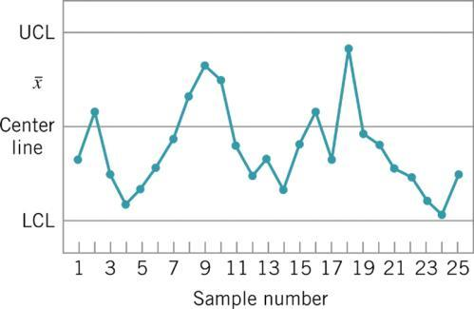
SPC: oefening 1
Wanneer een proces statistisch onder controle is, betekent dit dan noodzakelijk dat alle of bijna alle units van het geproduceerde eindproduct binnen de specificatielimieten zullen liggen?
Pas de Western Electric-regels toe op deze controlekaart:

Slide 73
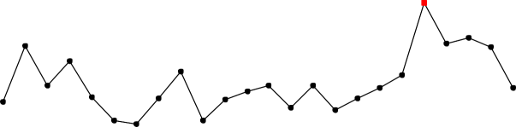
X bar R Chart: 2 charts,
1 of sample main and one of sample ranges (or spread)
Xbar-R Chart of Oil
1
1
60
Sample Mean
1
1
50
1
1
40
1
1
1
1
30
__U C L=31.59 X=28.46
LC L=25.32
20
Q uarter 1
Year 2000
1
1
3
2000
1
2001
3
2001
1
2002
3
2002
1
2003
3
2003
1
2004
3
2004
1
2005
3
2005
10.0
1
Sample Range
7.5
UC L=7.88
5.0
_
R=3.06
2.5
0.0
LC L=0
Q uarter 1
Year 2000
3
2000
1
2001
3
2001
1
2002
3
2002
1
2003
3
2003
1
2004
3
2004
1
2005
3
2005
Notes:
For samples larger than 10, s-charts are recommended over R-charts, because s is much more efficient for estimating the process
standard deviation s. For small samples and for manual maintenance of control charts, R is preferred over s.

Slide 74
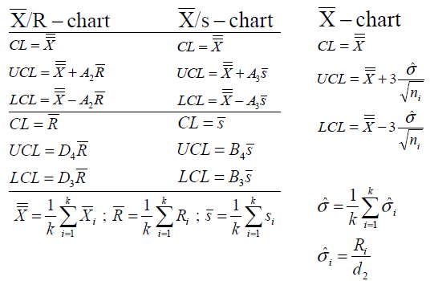
Xbar/R- en Xbar/s-kaart (R small sample < 10)
Vaste sample grootte Variabele sample grootte
Notes:
Uitleggen van waar die letters komen, verwijzen naar tabel.

Slide 75
SPC: oefening 2
Het nettogewicht van een bleekproduct moet opgevolgd worden dmv Xbar en R controlekaarten, met een samplegrootte van n=5. Gegevens van 20 voorbereidende samples worden getoond in deze tabel.
a) Stel de Xbar en R controlekaarten op.
Is het proces statistisch onder controle?
b) Schat het procesgemiddelde en
bepaal UCL en LCL
c) Met 16,2 +/- 0,5 als specs, wat kan
je concluderen ivm de capabiliteit (C_{p} C_{pk})?

Slide 76

Oefening 2 in Minitab

Slide 77


Slide 78


Slide 79


Slide 80


Slide 81


Slide 82


Slide 83


Slide 84
SPC: oefening 3
De gegeven data zijn Xbar en R waarden voor 24 samples van grootte n=5, genomen uit een proces dat lagers produceert. De metingen werden uitgevoerd op de binnendiameter van de lager, met enkel de laatste 3 decimalen genoteerd. (bv. 34,5 moet 0,50345 zijn).
Stel de Xbar en R controlekaarten op. Is het
proces statistisch onder controle?
Indien nodig, herzie de testcontrolelimieten.

Slide 85
SPC: oefening 4
Neem de xbar en R kaarten uit de vorige oefening, met n=5.
a) Stel dat je dit proceskenmerk verder zou willen monitoren met Xbar en R kaarten gebaseerd op een samplegrootte van n=3. Welke limieten zou je dan gebruiken?
b) Wat zouden de limieten zijn indien n=8?
c) Wat zou de impact van deze beslissingen zijn op de mogelijkheid om een verschuiving van 2*sigma van het gemiddelde te ontdekken?
Notes:
Vraag c: bij een kleiner sample, vergroten de limieten, maar ook de standaardafwijking: wat is het effect hiervan?

Slide 86
SPC: oefening 5
Samples van grootte n=5 worden elk uur uit een productieproces genomen. De kwaliteitskarakteristiek is normaal verdeeld. Xbar en R worden voor elke sample gemeten. Na 25 samples hebben we volgende gegevens:
Veronderstel dat beide kaarten statistisch onder controle zijn. Indien de specificaties 26,40+/-0,50 bedragen, wat is dan de procescapabiliteit? Wat is het percentage aan niet-correcte eenheden dat we mogen verwachten?
Wat zou dit percentage bedragen indien het procesgemiddelde 26,40 zou zijn?
  (hint: gebruik de cumul. standaardnormale verdeling)

Slide 87
SPC: oefening 6
Een kritische dimensie van een gefreesd stuk heeft als specificaties 100 +/- 10. Analyse van de controlekaart toont aan dat het proces onder controle is met Xbarbar= 104 en Rbar = 9,30. De samplegrootte is n=5.
s = Rbar / d2 = 9,3/2,326 =~ 4
Indien we aannemen dat de karakteristiek normaal verdeeld is, kunnen we dan het gemiddelde zo aanpassen (door de freespositie aan te passen) dat alle output voldoet aan de specificaties?
Neen, 3 sigma = 12: buiten specs
Wat is de huidige capabiliteit van het proces?
Cp = 20/24 = 0,83
Cpk = min [ (104-90)/(3.4) ; (110-104)/(3.4) ] = min [ 1,17 ; 0,5 ]

Slide 88
Voorbeelden OSPC AMGent

Slide 89

Ondersteuning voor bewaken productkwaliteit
OSPC controle door productie – bewaking meetmiddelen
OCAP
tolerantiegrenzen

